Slide 1

Functional Verification using Machine Learning Techniques
Done by: Mahmoud Tamer
Supervised by: Dr. Amr Talaat
Reviewed by: Dr. Mohamed Refky

Slide 2
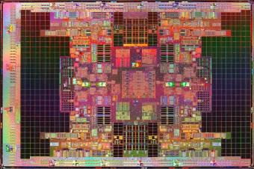

Prologue

Slide 3

Prologue

Slide 4
Table of Contents
Introduction to Verification
Functional Verification’s Problem
Why Machine Learning can Solve our Problem
Related Work
Proposed Novel Approach
The Work
Results
Conclusion & Future Work

Slide 5

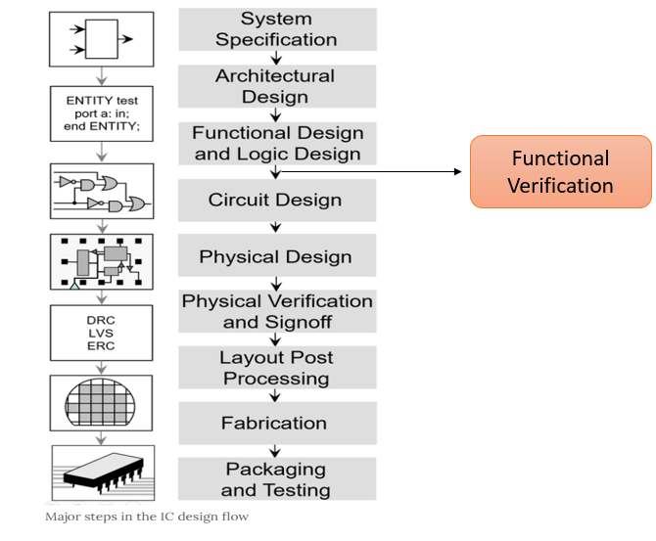
Introduction
Technology Era
Functional Verification in IC Design Process

Slide 6
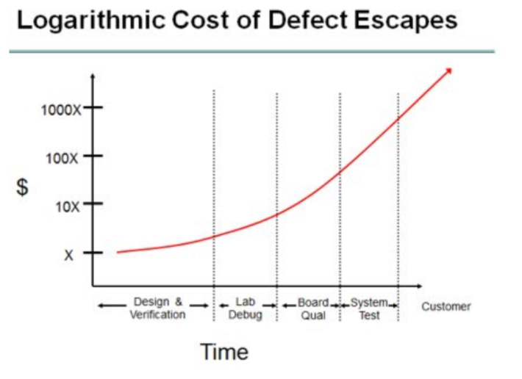
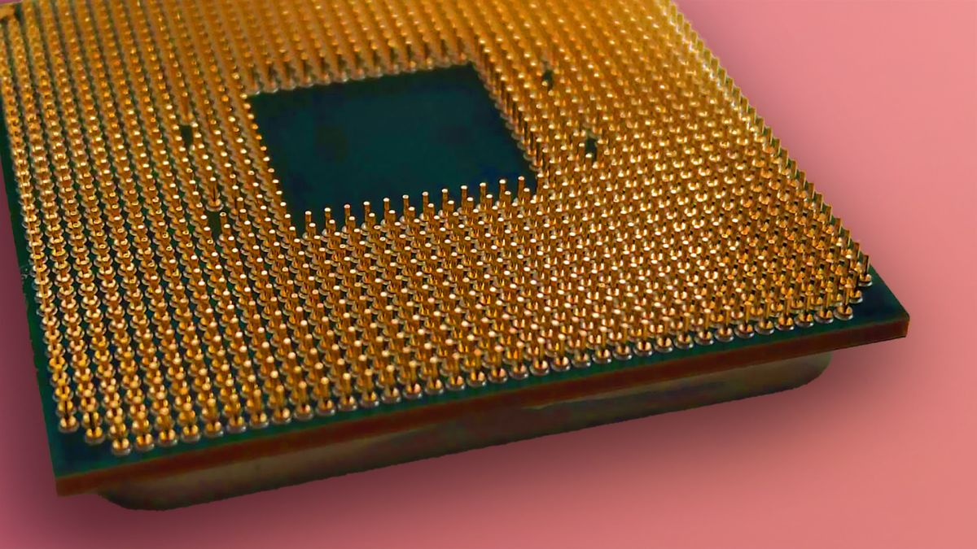
Introduction
Importance of Verification
Abstract View of Verification
$475 Million

Slide 7
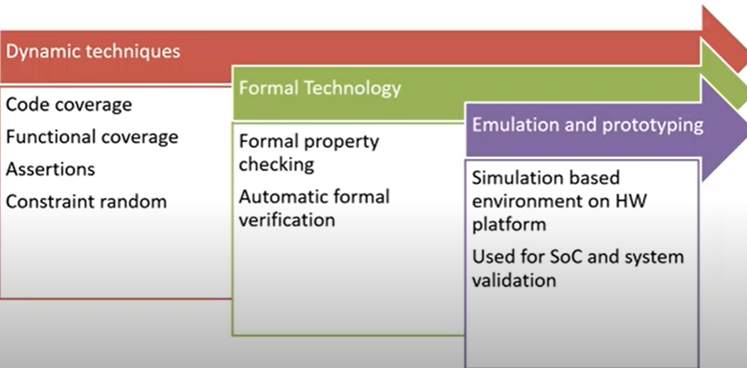
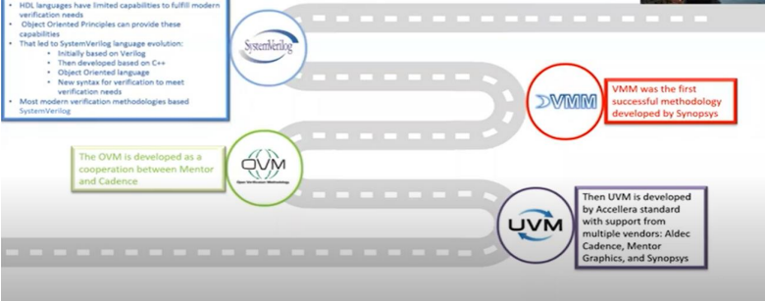
Introduction
Verification Techniques
Functional Verification Between the Near Past and Future

Slide 8
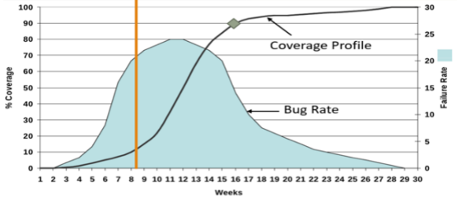
Functional Verification’s Problem
Modern Integrated Circuits’ Complexity
Huge Time Consumption

Slide 9
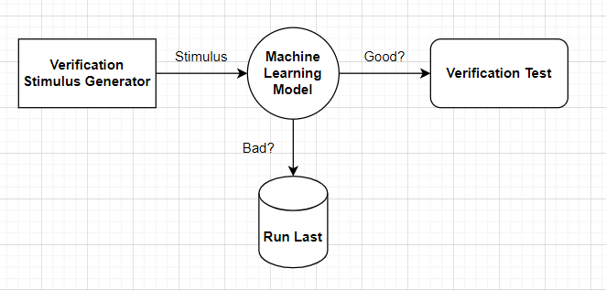
Why Machine Learning can Solve our Problem
What is Machine Learning
How can Machine Learning Enhance Functional Verification

Slide 10
Table of Contents
Introduction to Verification
Functional Verification’s Problem
Why Machine Learning can Solve our Problem
Related Work
Proposed Novel Approach
The Work
Results
Conclusion & Future Work

Slide 11

Related Work
Stimulus & Assertions Generation, Debugging, and Datamining
Highlights of Related Work

Slide 12
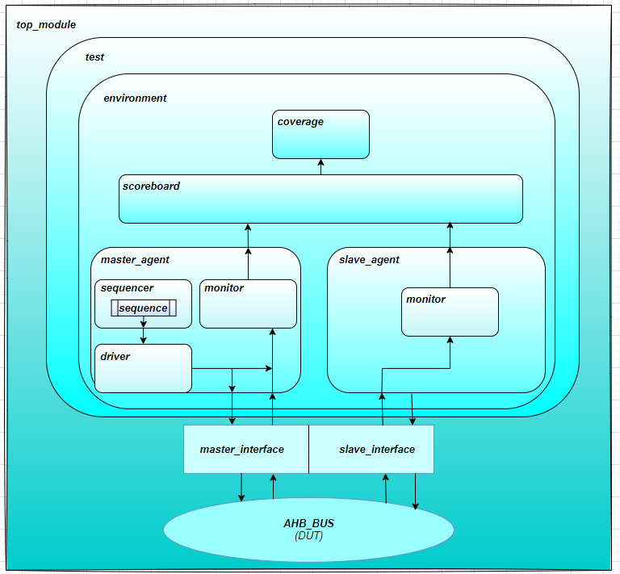
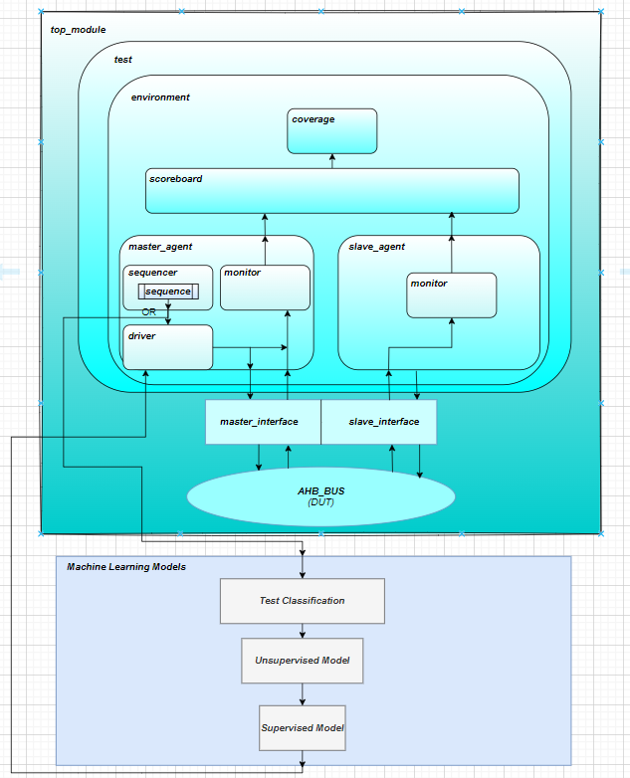
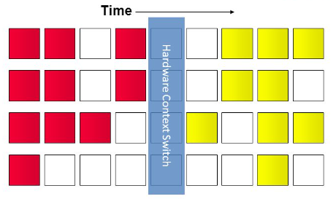
Proposed Novel Approach
UVM Verification Environment
3 Layers Machine Learning Model
ML Model Running Mechanism in the UVM Environment

Slide 13
Table of Contents
Introduction to Verification
Functional Verification’s Problem
Why Machine Learning can Solve our Problem
Related Work
Proposed Novel Approach
The Work
Results
Conclusion & Future Work

Slide 14
The Work
Used Tools and Sources
Test Plan and Testing Metric
ML Enhanced Tests
Directed Tests
Error Injection Tests
Tool | Use
GitHub AHB Bus RTL | DUT
Mentor Questa | UVM Simulator
Do Files | Compilation & Simulation Scripts
Sublime | Text Editor
Spyder | Machine Learning IDE & Results Generator
Miniconda | Python Libraries
Draw.io | Graphs & Figures
Simulation Cycles
Notes:
Sources for AHB bus, mention everything including Miniconda, drawing….etc
Our 5 tests and the 3 different ways to run them having simulation cycles as the metric

Slide 15
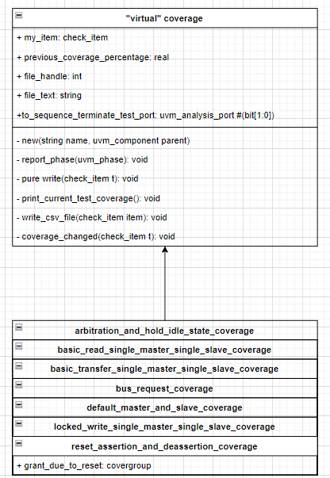
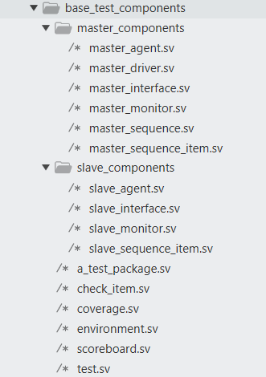
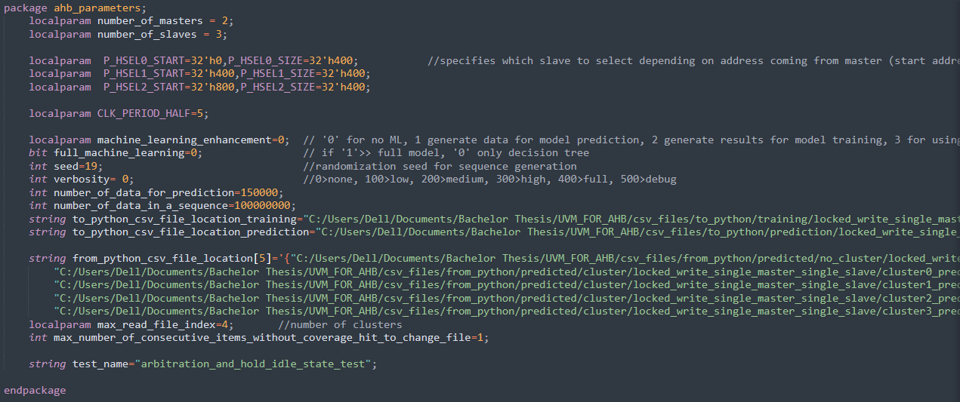
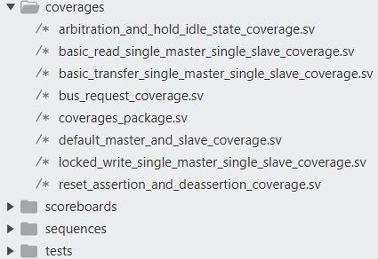
The Work
UVM’s Base Test Components
UVM’s Specific Test Components

Slide 16
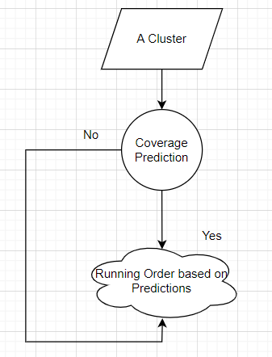
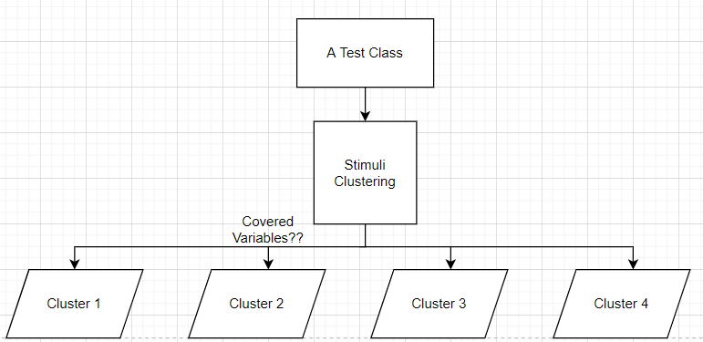
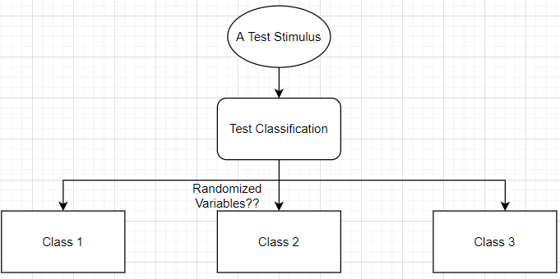
The Work
Stage 1: Explicit Artificial Intelligence (Test Classification)
Stage 2: Unsupervised Machine Learning (Clustering)
Stage 3: Supervised Machine Learning (Coverage Prediction)
Notes:
Talk about used decision trees, k-clustering and reasons for choosing them.
Talk about pruning and elbow methods…etc

Slide 17
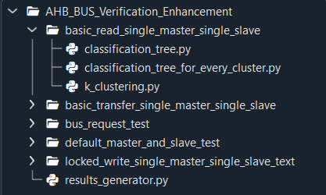
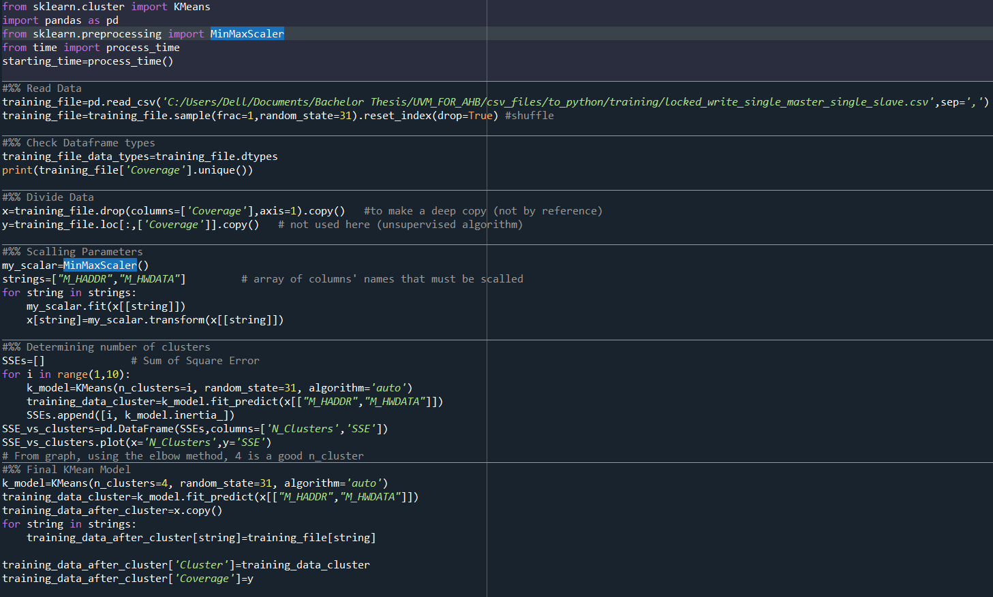
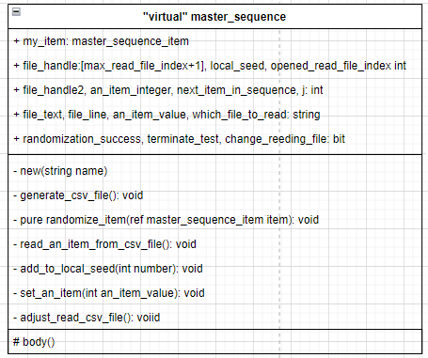
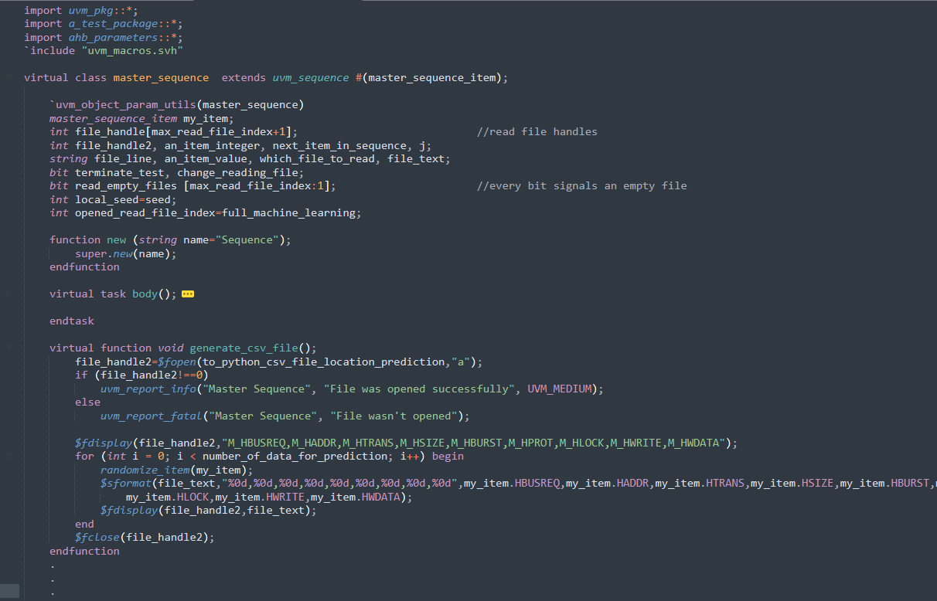
The Work
UVM Environment Code View
Machine Learning Code View

Slide 18
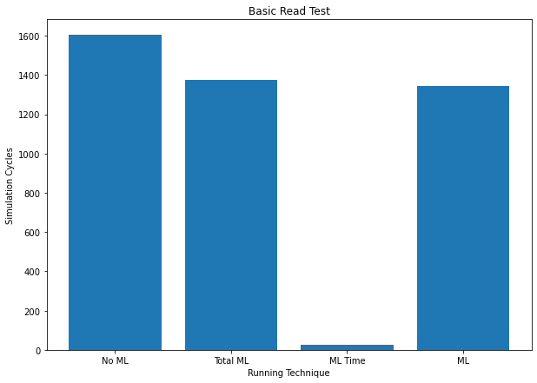
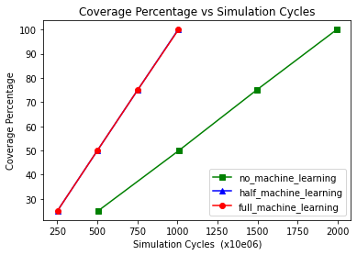
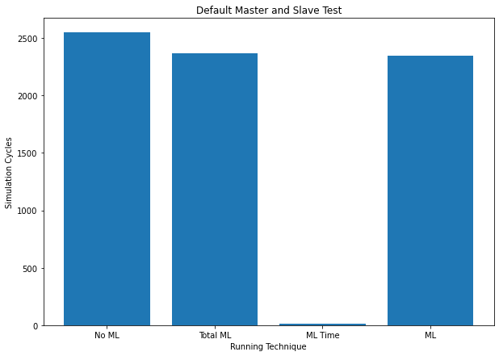
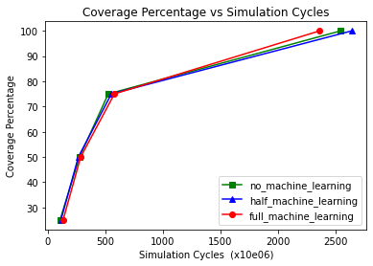
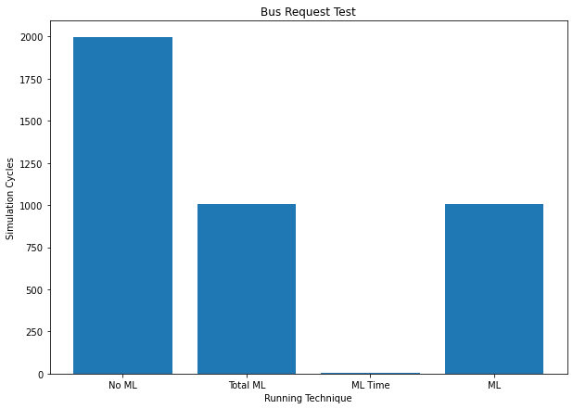
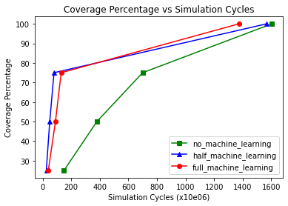
Results (ML Tests)
Test 1 “Bus Request”
Test 2 “Default Master and Slave”
Test 3 “Basic Read”

Slide 19
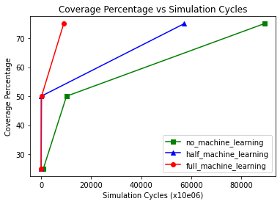
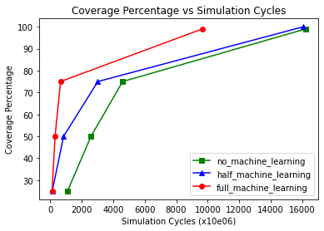
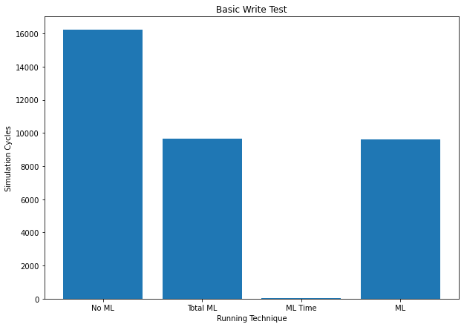
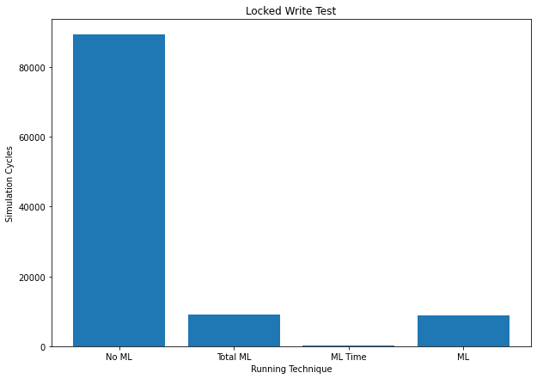
Results (ML Tests)
Test 4 “Basic Write”
Test 5 “Locked Write”
Notes:
40, 90

Slide 20
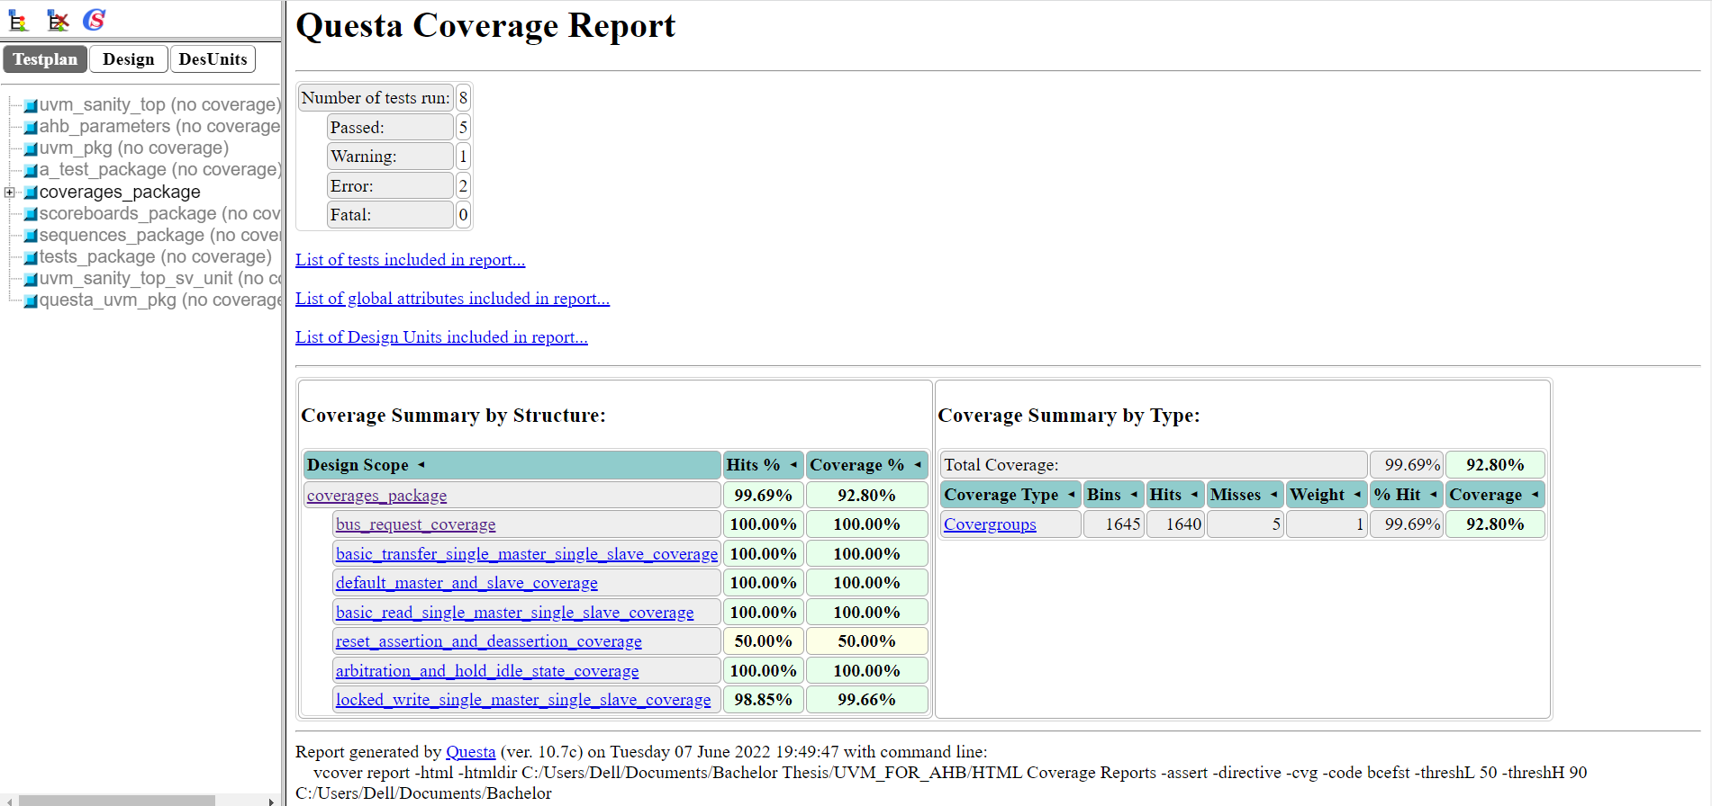
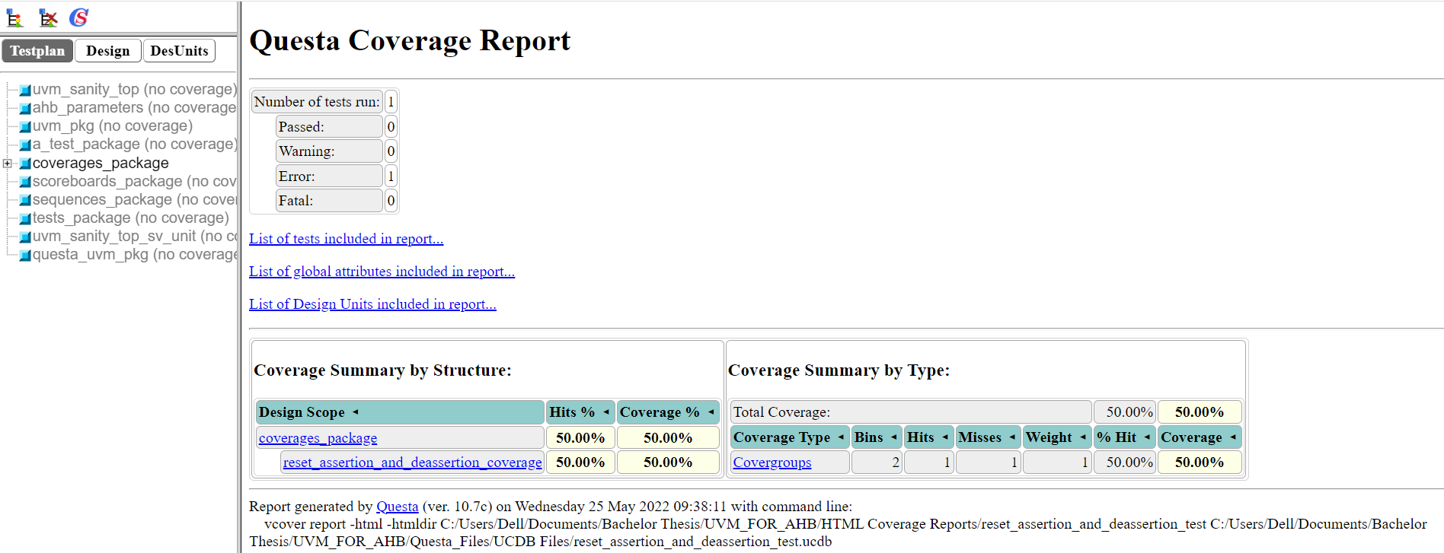
Results (Directed & Faulty Tests)
Reset Assertion and De-assertion
Arbitration and Holding Idle State

Slide 21

Running an Example
Lets show our actual testing process.

Slide 22
Table of Contents
Introduction to Verification
Functional Verification’s Problem
Why Machine Learning can Solve our Problem
Related Work
Proposed Novel Approach
The Work
Results
Conclusion & Future Work

Slide 23

Conclusion & Future Work
Our Work’s Summary
Our Drawbacks

Slide 24


Conclusion & Future Work
Future Work & Suggestions
Personal Opinion

Slide 25
Questions?

Slide 26
Thank You ☺

